Slide 1




1QPoint
Your Partner for Accurate Weather
Notes:
Hello, we’re 1QPoint and we’re a quantum weather forecasting team dedicated to making sure you’re prepared for both sunny and rainy days.

Slide 2



02
For those unexpected rainy days.
Every forgot to bring an umbrella? Ever disgruntled at how the NOAA super computers seem to get it wrong all the time? 1QPoint offers proprietary quantum weather forecasting algorithms.
Notes:
In 2020 alone the US had 22 weather related events resulting in 100 billion $US damage cost and 300 deaths! We believe that quantum computing algorithms can be incredibly promising in bringing greater accuracy to weather forecasting and by doing so to save people’s lives and make business thrive!

Slide 3
Why Quantum Weather?
03
Notes:
So why should you care about quantum weather? Here to explain is Ricky…

Slide 4



Don't Be Left Behind
Quantum Advantage
Faster Detection
Efficient Data Storage
04
Notes:
Our experts believe that there is a quantum advantage.
We can provide faster detection
And eventually we believe that quantum computers can efficiently store vast amounts of weather data.

Slide 5
$3.3 Billion
by 2025
05
Notes:
Hello, we’re 1QPoint and we’re a quantum weather forecasting team dedicated to making sure you’re prepared for both sunny and rainy days.

Slide 6
H
Phase/
Amplitude
Embedding
H
H
H
Embedding
Circuit
Encoding the classical data into quantum circuits is an important step as we move toward quantum machine learning applications.
H
H
H
H
06
Notes:
We provide innovative solution by // encoding the image data into quantum circuit.
Image data such as inferred, // radar, // and statlite images are widely used in weather forecasting.
If we can map
our information of the pixel
into the quantum state.
We can take adventage of quantum algorithm
to predict the alarming event fast.
For example,
After encoding the data, we apply to grover search algorithm to find suspicious event in the image.

Slide 7
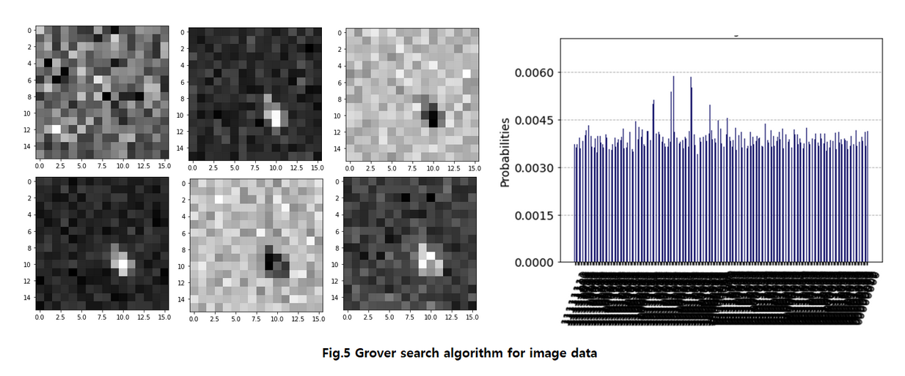
Grover's Search
07
Notes:
Here, you can see that as we increase the interation of Grover algorithm.
Bright spots are showing up, and we can easily distingue the spot.
Since Grover algorithm has quadratic speed up over classical computer for finding the unique dataset
This algorithm can be very useful for detecting the suspicious activity from the image.

Slide 8
















Quantum Machine Learning
H
$$R_{Y}$$
$$R_{Y}$$
H
$$R_{Y}$$
$$R_{Y}$$
H
$$R_{Y}$$
$$R_{Y}$$
H
$$R_{Y}$$
$$R_{Y}$$
Qubit
Embed
PQC
$$R_{Y}$$
$$R_{Y}$$
H
$$R_{Y}$$
$$R_{Y}$$
H
$$R_{Y}$$
$$R_{Y}$$
H
$$R_{Y}$$
$$R_{Y}$$
H
08
arXiv:1905.10876
Notes:
Our second solution is utilizing the near-term quantum machine learning model
We choosed high expressive and good entanglement capable quantum circuit
from the paper by Hannah Sim,
[Click]
Using the quantum circuit, we encode the image data,
train our quantum circuit..
After the training, our quantum circuit can classify the image information.

Slide 9
09
Use Case
Notes:
Those two unique solutions have numerous applications as we are building toward fault tolerant quantum computer.
We would like to introduce our two use cases of our solutions.

Slide 10
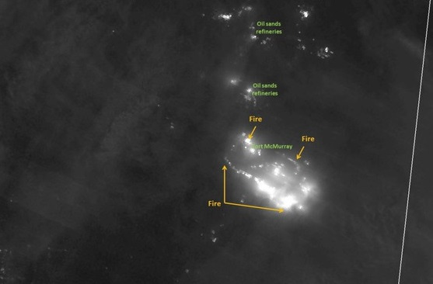
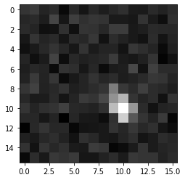
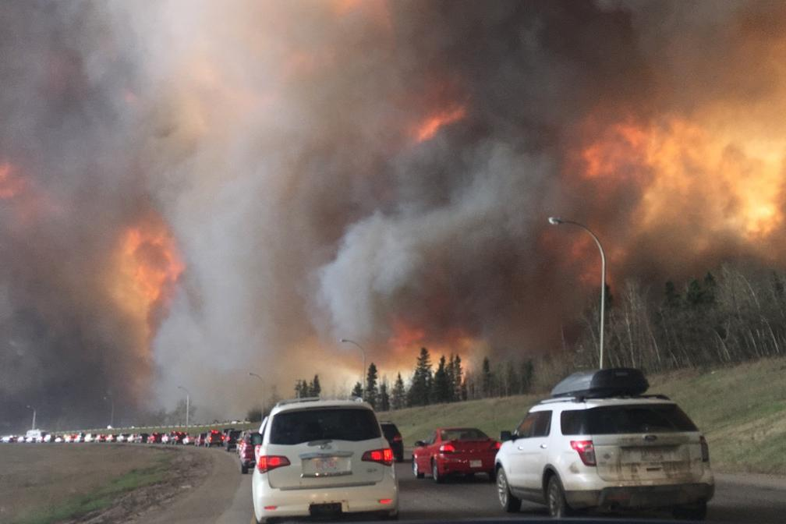
WildFire Detection
with fireQ
01
02
Grover detection can sense fires immediately after ignition, reduce the response time for local fire department and minimizing the risk
This detection method can be applied for faster detection of suspicious event in the image data such as radar image for enemy air defenses
10
Notes:
this is the McMurray wildfire in 2016.
88,000 people forced from their home.
If we can detect those event early,
those catastrophic event can be prevented.
On the top, you can see the satellite image of the event.
Our integrated solution
[Click]
can distinguish the location of interest, faster .
[Click]
Another important point of our solution is it is not only limited to the wild fire detection.
Anything brings high temperature which can be detected
by inferred // radar //
We can provide fast detection using quantum advantages.

Slide 11
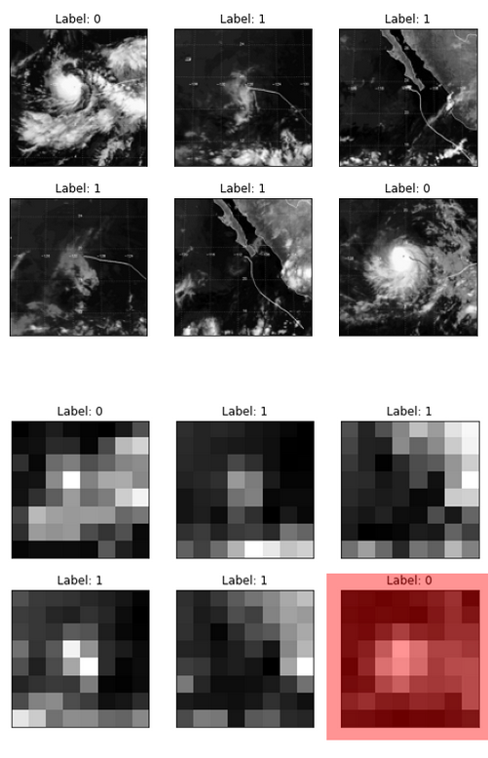
Storm Detection
with cloudQ
The ability to perform an efficient mapping of classical data on quantum bits will be beneficial for predicting the weather forecast with accuracy of
90%
11
Notes:
Our next case is using our quantum machine learning model
to train the stalite image.
[Point]
As you can see on the image, we can have storm or sunny data.
[Click]
We trained our quantum circuit,
We were able to obtain with 90% accuracy for test data.
This will help us to predict the future strom event more accurately.
Our solution will not only give you information for bringing an umbrella tomorrow,
This will save people’s life and their asset.

Slide 12
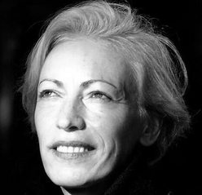
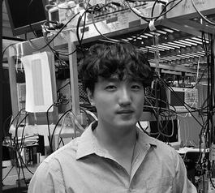
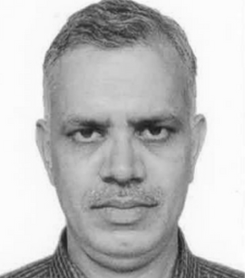
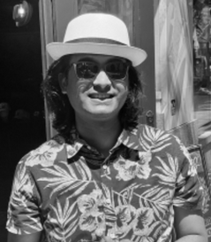
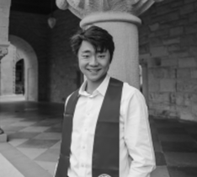
Our Team
Silvia Tzenkova
Saesun Kim
Dr Ashish Mani
Business Development
Phd Candidate, Oklahoma University
Professor, Amity University
13
Ritaban Chowdhury
Ricky Young
Machine Learning Engineer
B.S. Applied Physics
Notes:
All these work cannot be done without our passionate team members.
We have strong business expertise as well as quantum and classical engineers.
We are really happy to present our two weather solution in CDL

Slide 13
09
THANK
YOU
Any questions?
Use Case
Notes:
Thank you for your attention, and
See more details on business application and
challenge questions in GitHub.

Slide 14
"Everybody talks about the weather, but nobody does anything about it."
-CharlesDudley Warner
14

Slide 15



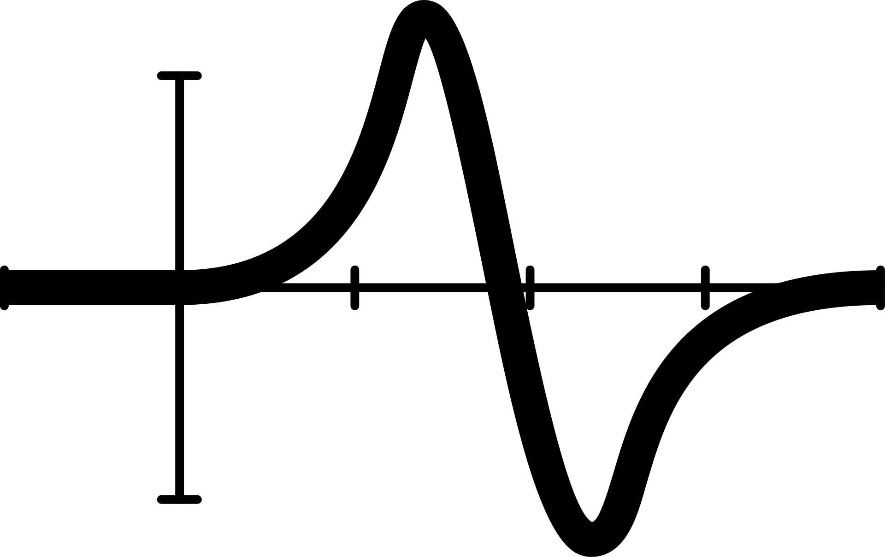
Our method
Get Satellite
Images, and other relevant data
Predict in real time if there is possibility of calamity using QPU and GPU
Inform via rest API to give customers Risk score
15

Slide 16
20,000,000
OUR IMAGE CLASSIFICATION CAPABILITIES
15,000,000
10,000,000
are only set to grow!
5,000,000
0
50 Qubits
100 Qubits
150 Qubits
250 Qubits
16

Slide 17



OUR COMPETITORS

